Slide 1
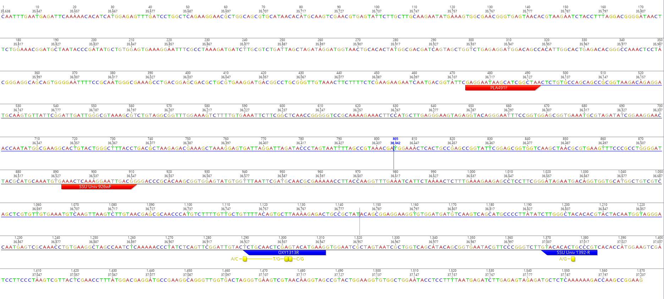
Universal primers -> 16S plastid - 492 bp

Slide 2
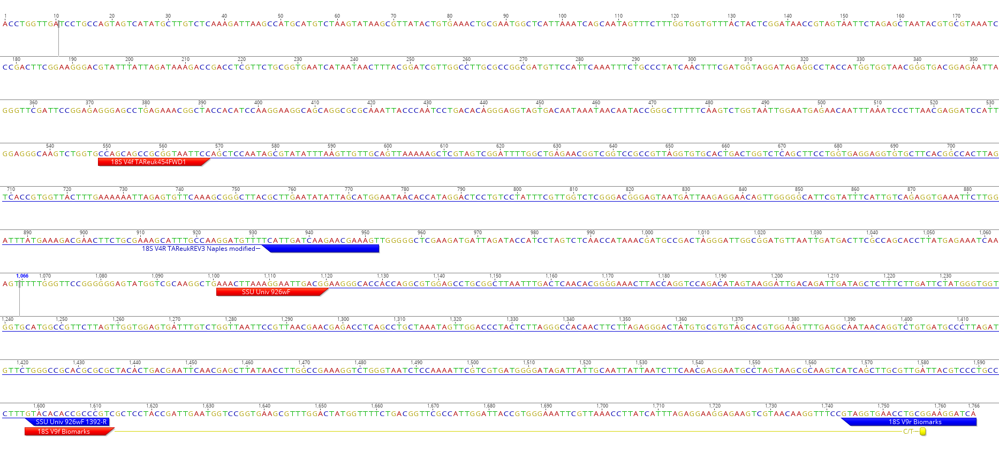
Universal primers -> 18S nuclear - 512 bp.

